Slide 1
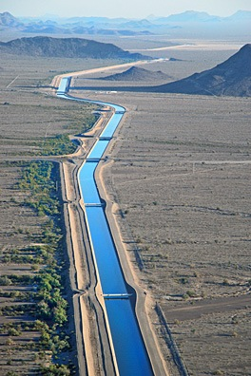
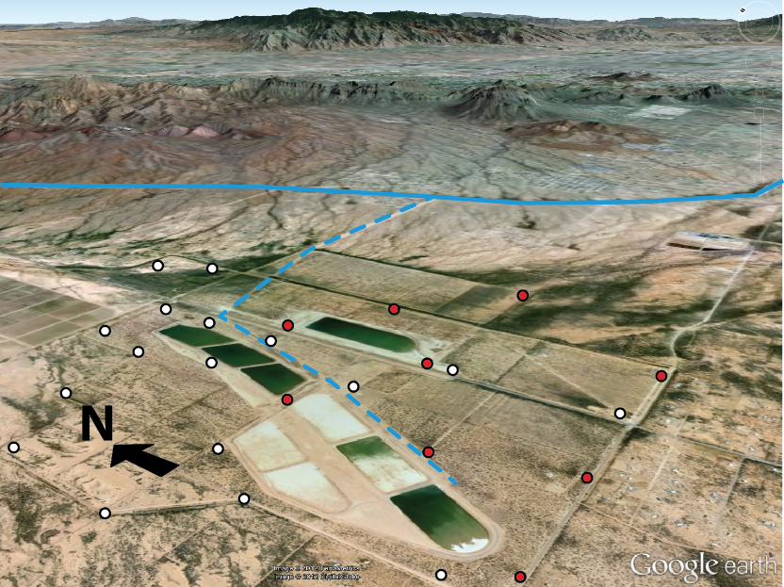
Tucson gets its water from the Colorado River and stores it temporarily underground in Avra Valley
TUCSON
AVRA VALLEY

Slide 2
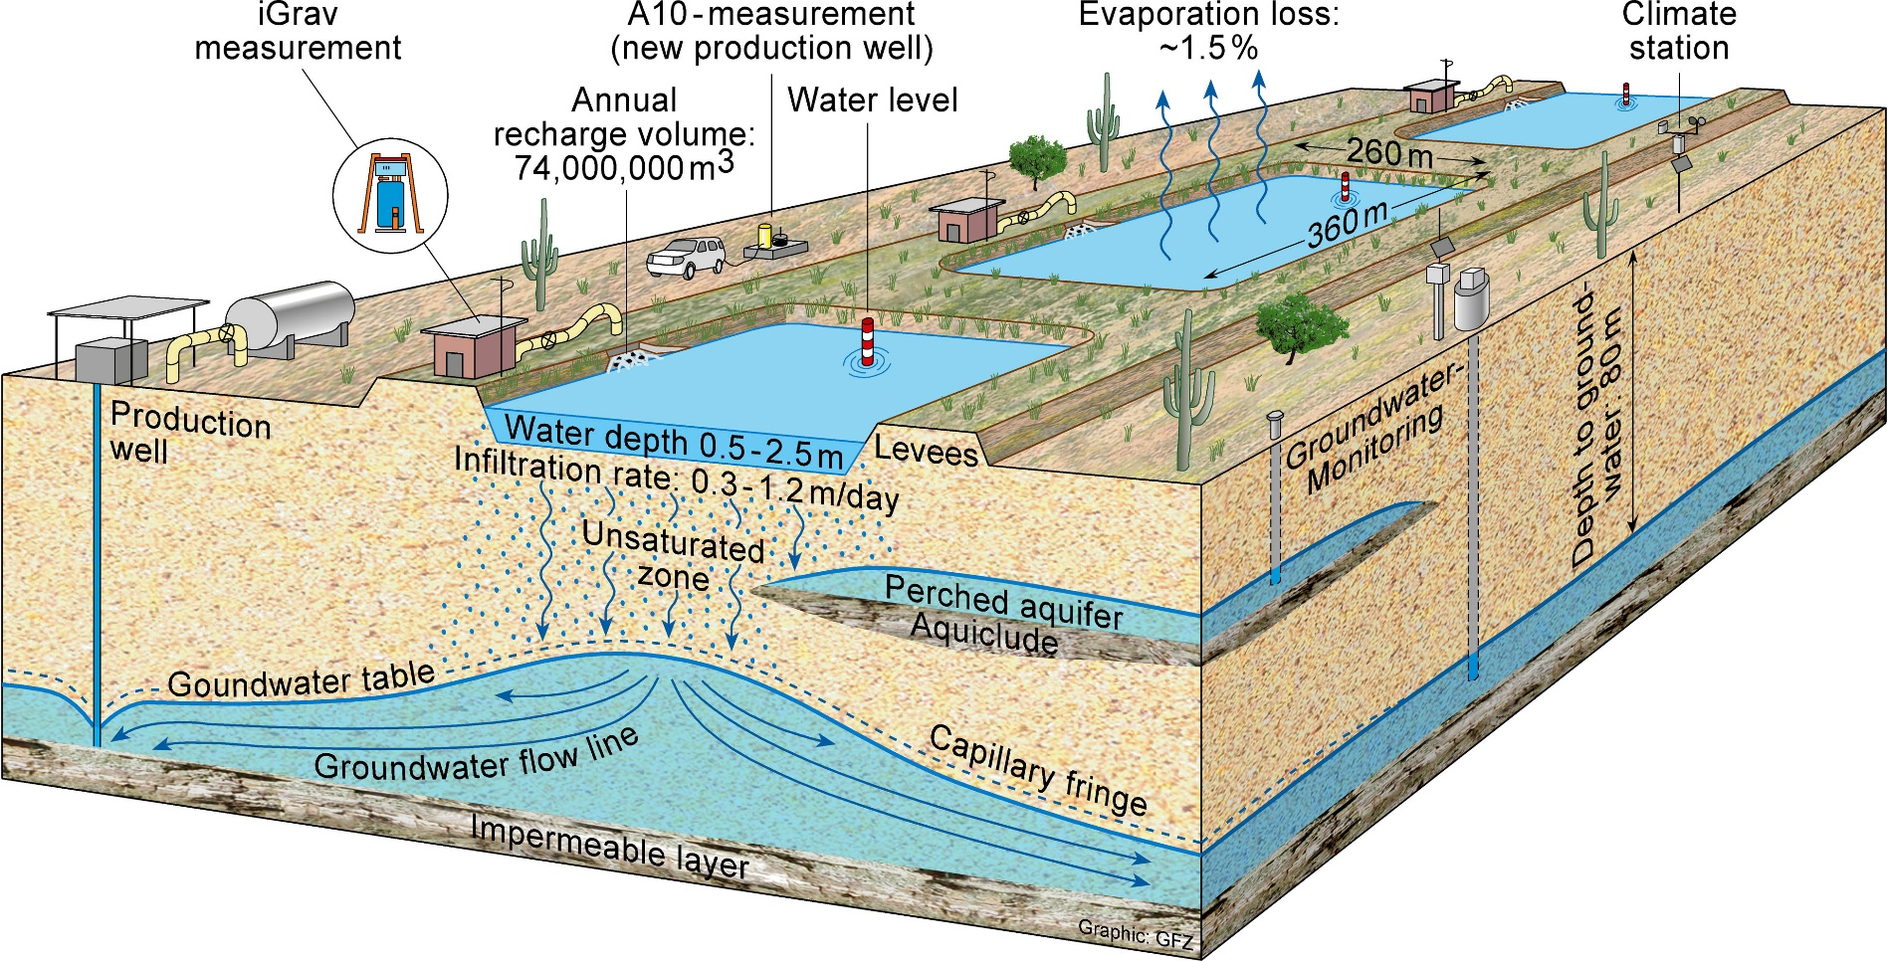
SAVSARP in Avra Valley
Where does it go after it soaks into the ground?

Slide 3
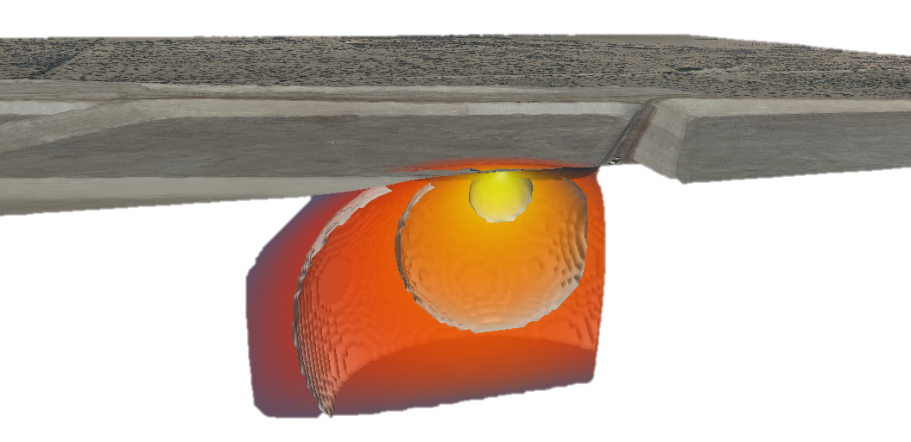
74 million tons of water “soak into the ground” at the SAVSARP facility each year
This changes the local gravity field; by measuring changes in gravity we can track where the water is going
Newton’s law of gravitation:
g =-z/r³
g ≈ 9.800000xxx m/sec²
microgals

Slide 4
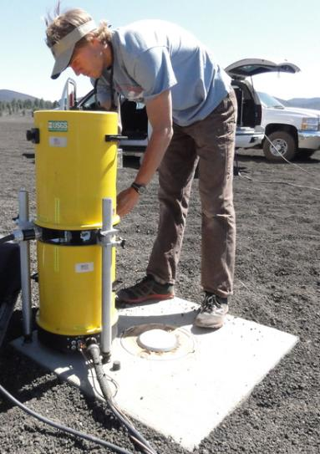
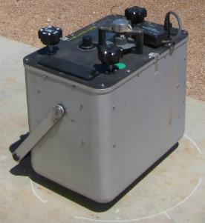
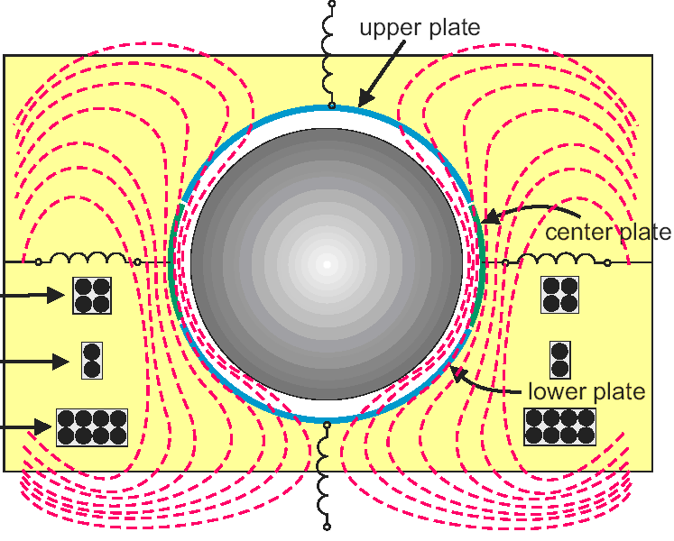
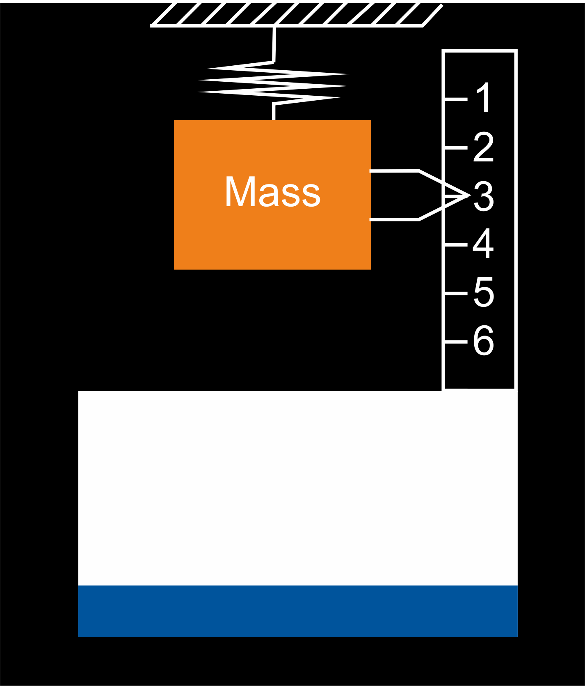
Gravity’s measured by:
Dropping
A spring

Slide 5
Gravity’s measured by:
Dropping

Slide 6
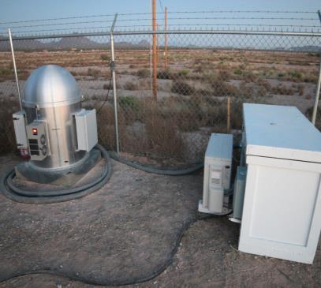
Gravity’s measured by:
Dropping
A spring

Slide 7
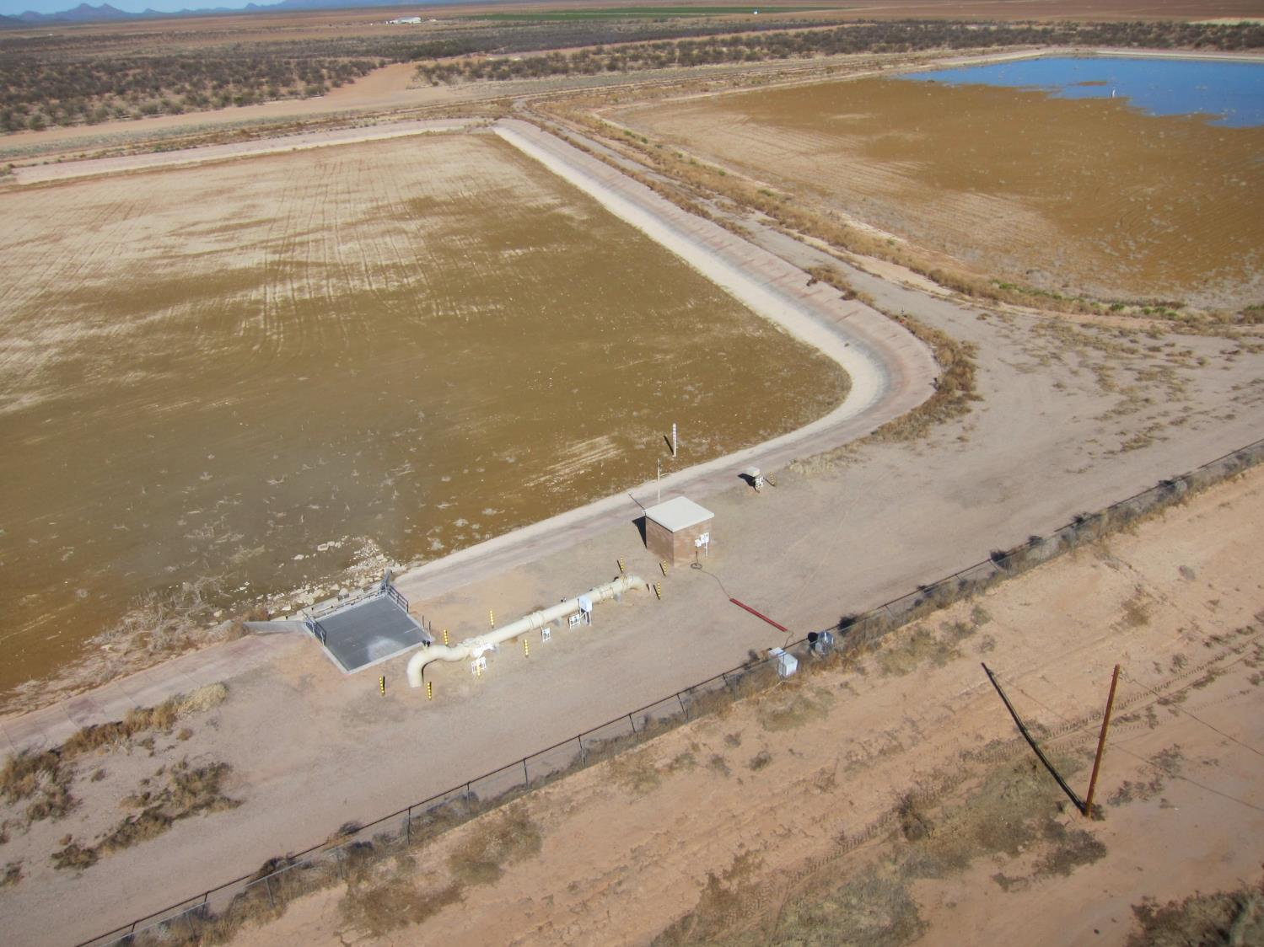

Slide 8
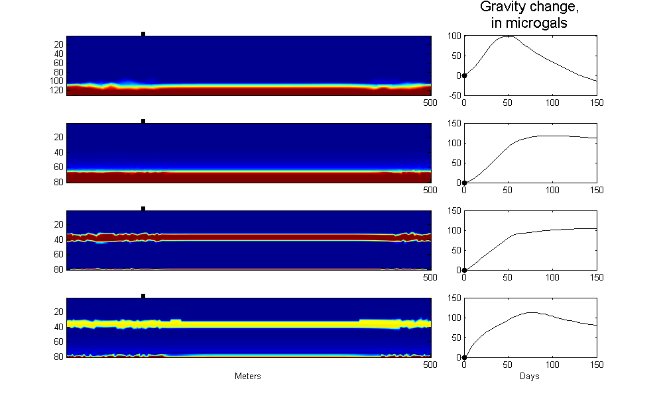
Simulating gravity change at one point
x-z profile
Color indicates saturation
Days

Slide 9
Simulating gravity change at one point
x-z profile
Color indicates saturation
Days

Slide 10
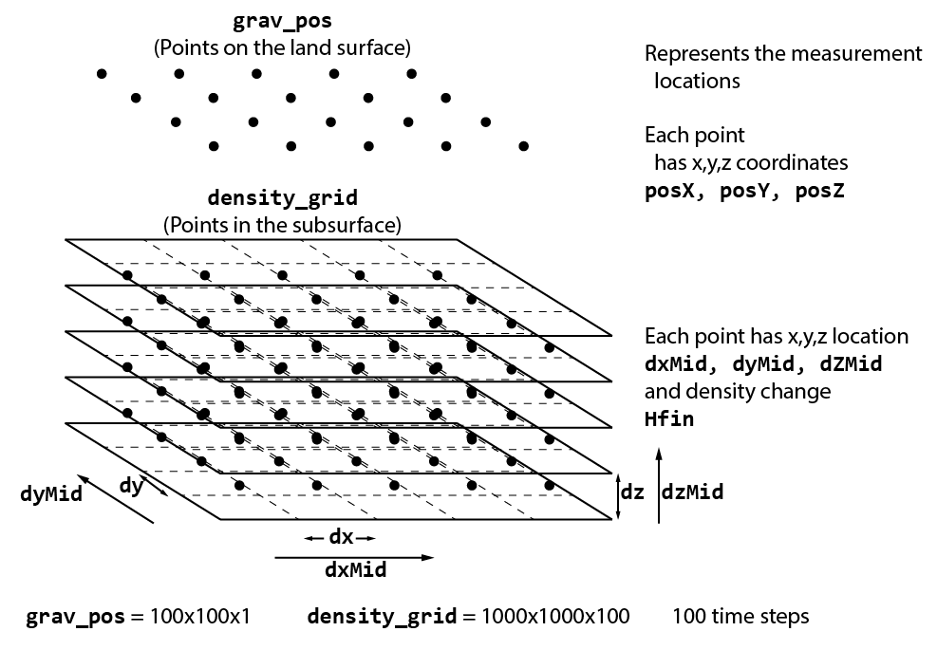

Slide 12
Gravity calculation – prism.py
def calc_prism( dx, dy, dz, dxMid, dyMid, dzMid, Hfin, posX, posY, posZ):
import math
GAMMA=6.67e-8
RHO=1
x = [ dxMid - dx/2 - posX, dxMid + dx/2 - posX ]
y = [ dyMid - dy/2 - posY, dyMid + dy/2 - posY ]
z = [ dzMid - dz/2 - posZ, dzMid + dz/2 - posZ ]
gsum = 0;
for i in range(2):
for ii in range(2):
for iii in range(2):
rf = math.sqrt((math.pow(x[i],2) + math.pow(y[ii],2) + math.pow(z[iii],2)))
gsum += math.pow(-1,(i+ii+iii+3))*(x[i]*math.log(y[ii] + rf) + y[ii] *
math.log(x[i]+rf) - z[iii]*math.atan(x[i]*y[ii]/z[iii]/rf))
return GAMMA * Hfin * RHO * 1e8 * gsum

Slide 13
“Wrapper” function – grav.py
#!/usr/bin/python
import sys
from prism import calc_prism, calc_macmillan, calc_pointmass
from math import sqrt, pow
dx, dy, dz = (10., 10., .1)
grav_pos = []
density_grid = []
r2exac = 10.
r2macm = 81.
# read density grid
fid = open(sys.argv[1],'r')
for line in fid:
density_grid.append([float(x) for x in line.split()])
fid.close()
# read gravimeter positions
fid = open(sys.argv[2],'r')
for line in fid:
grav_pos.append([float(x) for x in line.split()])
fid.close()
g, g_out = ([],[])
fid = open(sys.argv[1]+'.out','w')

Slide 14
“Wrapper” function – grav.py (cont.)
# calculate gravity for each density_grid point
fid = open(sys.argv[1]+'.out','w')
for each_grav_pos in grav_pos:
g_sum = 0;
for dens in dens_grid:
dxMid = prism[0]
dyMid = prism[1]
dzMid = prism[2]
hfin = prism[3]
rad = sqrt((dxMid-each_grav_pos[0])**2 +
(dyMid-each_grav_pos[1])**2 +
(dzMid-each_grav_pos[2])**2)
r2 = rad**2
dr2 = dx**2 + dy**2 + dz**2
f2 = r2 / dr2
if f2 <= r2exac:
#print 'prism'
g_prism = calc_prism(...
elif f2 >= r2macm:
#print 'pm'
g_prism = calc_pointmass( ...
else:
#print 'mac'
g_prism = calc_macmillan( ...
g.append(g_prism)
g_sum += g_prism
fid.write(str(g_sum)+'\n')
print g_sum
fid.close()

Slide 15
Command line:
[student@serviceo ~]$ python grav.py density_grid.txt grav_pos.txt
input files:
density_grid.txt (1e8 lines)
Timestep X Y Z Density
1 1 1 0.5 10.234
1 1 2 0.5 12.007
1 1 3 0.5 10.744
...
output file – <input file>.out:
ID Timestep g
1 1 -3135.59626477
2 1 -60288.6342747
3 1 -130918.937486
grav_pos.txt (10,000 lines)
ID X Y Z
1 0.1 0.1 2.
2 20 20 2.
3 30 30 2.
...

Slide 16
https://github.com/jrkennedy44/grav_parallel.git
grav.py
prism.py
Sample data:
density_grid.txt: 1 x 100 x 100 x 100
grav_pos.txt: 3 x 1
“Big data”
data_test1.tgz
test1_density_grid.txt
test1_grav_pos.txt
jeffk@email.arizona.edu

Slide 17
Room for improvement
The regular mesh of x,y,z coordinates could be generated using numpy.meshgrid on the worker instead of including discrete coordinates in a grid.
Should we focus on making the input files smaller, or optimizing the gravity calculation?
Run time for a 100x100x100 density grid, with 10x10 gravimeter positions, for 1 time step is ~ 1 hour. 10-100x speedup or more?

Slide 18
“Extra Credit”
A python script that:
Opens an ssh session with futuregrid (from Windows?)
Transfers the files
Starts the Makeflow job
Transfers files back?
A way to vary dx, dy, dz so that the density_grid spacing doesn’t have to be constant

